Slide 1
Opportunities for Mobile Applications in Digital Services
Ms Jeanette Morwane
Chief Director: ICT Innovations
24 November 2021

Slide 2
INTRODUCTION
The vision is to have a digitally transformed South Africa where citizens are digitally empowered to create and participate in tech-enabled opportunities that drive inclusiveness, employment and economic transformation.
The Digital Economy has a potential to contribute immensely in the country’s GDP each year.
New emerging models have an opportunity to facilitate the creation of over 1 million new jobs over the next 10 years.
To take advantage of these opportunities, we would need to unlock some of the factors inhibiting the development and growth of SA’s digital economy.
We also need to ensure that the innovation ecosystem is effectively coordinated and integrated.

Slide 3
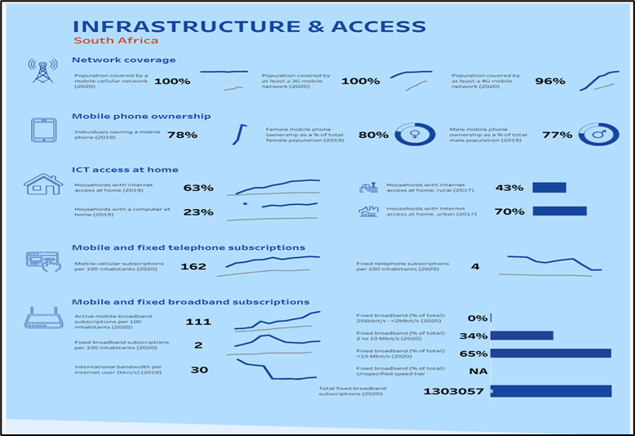
South Africa at a Glance – Infrastructure and Access
The State of the ICT Sector Report in South Africa – ICASA 2021

Slide 4
South Africa at a Glance –
Telecommunications Subscriptions
Mobile Cellular (Prepaid and Post-paid mobile Cellular Phone Voice) Subscriptions for rural and urban area
Mobile Cellular Active Subscriptions
Source: ICASA Electronic Communications Questionnaire 2020

Slide 5
South African Mobile App Market on Android
How Many Apps Are from South African App Publishers on Google App Store?
How Many Apps Are from Brazilian App Publishers on Google App Store?
There are more than 4,224 apps from South African publishers on Google Play Store out of the 2,831,722 apps.
There are more than 66,135 apps from Brazilian publishers on Google Play Store out of the 2,835,405 apps.
Source: South Africa App Market Statistics in 2021 (www.42matters.com)

Slide 6
Opportunities – Digital Economy
Framework for the Digital Economy
Big bets/Opportunities
Physical technology production
Transformative tech applications
Digital platforms
Digitally traded services
Digital inclusion
Skills for work
Critical enablers
Responsive governance
Innovation and competitiveness
Government digitization

Slide 7
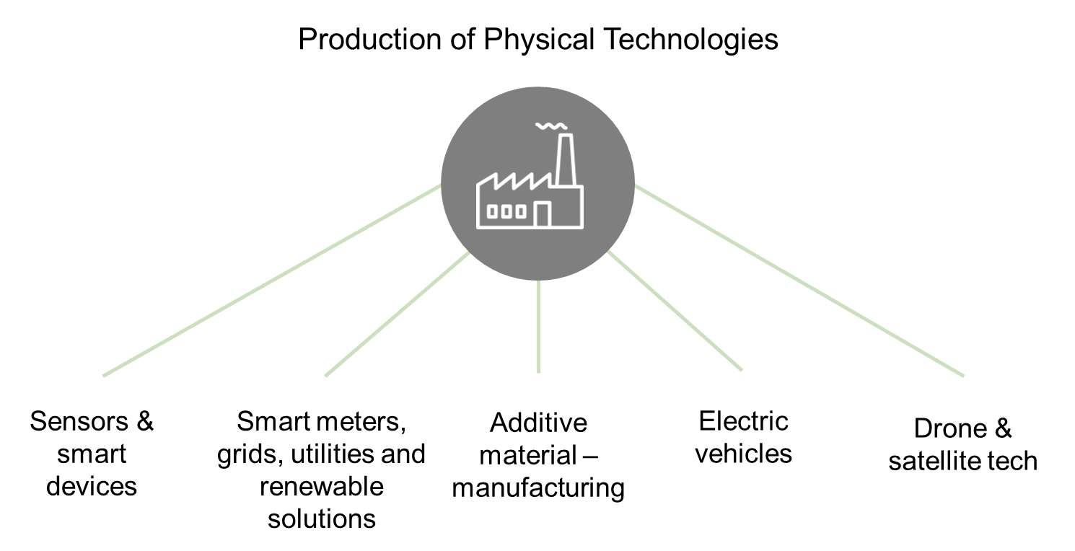
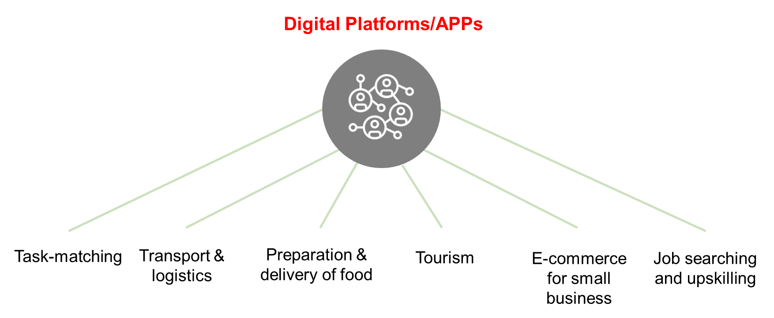
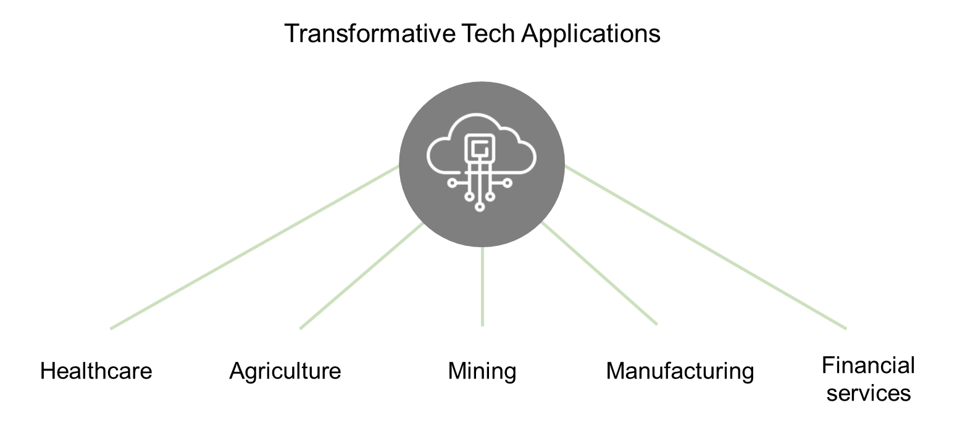
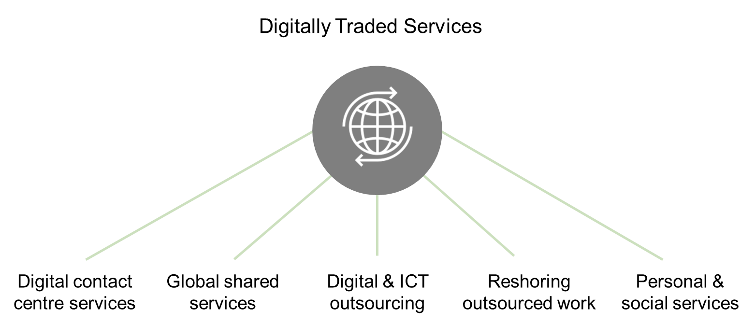
Opportunities – Digital Economy

Slide 8
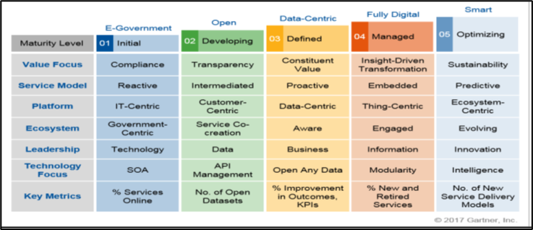
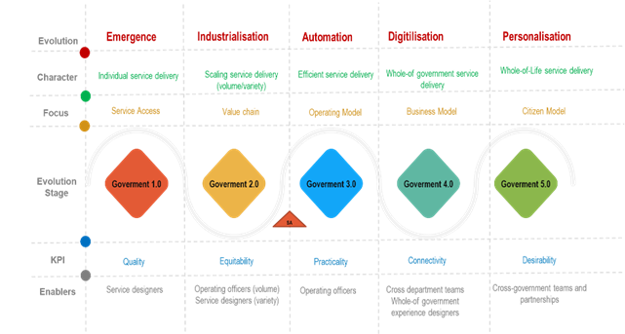
Opportunities – Digital Government
Figure 1: Digital Government Maturity Level
Figure 2: Public Sector Evolution Framework
The United Nations (UN) define digital government as not an end, but a means to improving public service delivery, increasing people's engagement, enhancing transparency, accountability, and inclusion and, ultimately to making life better for all. The Digital Government Maturity Model used to assess the public service’s state of readiness towards digital transformation thus being able to fulfil the Constitutional and Public Service Act (PSA) provisions.
The approach on the implementation of Government 5.0 requires addressing the following objectives:
Integrating public sector systems to enable digital transformation of public service;
Build sustainable infrastructure to enable digital government;
Review of the National e-Government Strategy to incorporate leveraging of disruptive technologies to drive innovation in public service; and
Secure public sector data: design systems that feature cyber security measures.

Slide 9
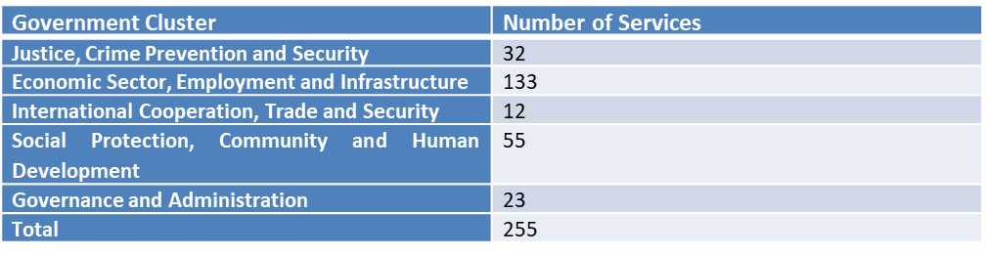
Opportunities – Digital Government
National e-Government Portal with “single-view of citizen”, integrating big data, AI and internet of things (IoT) capabilities;
Digitised services (e-services) for all government departments;
Use of mobile apps for access to e-services and social media tools for citizen participation

Slide 10
Opportunities – Postal Services
Digital Postal Services accessed via mobile – UPU Digital Postal Survey 2017

Slide 11
Proposed Government Support
A new government procurement dispensation for digital technologies and innovations developed locally will therefore be a game-changer, where government becomes a first customer.
Partnership with companies such as Google in supporting mobile innovations companies with technological support to grow.

Slide 12
